Slide 1
BI TOOL
Qlik

Slide 2
overview
swiftest growing BI and data visualization tool, which is quick-to-deploy, easy-to- learn, and perfect to get started with data visualization.
Key Features
• Consolidating relevant data from multiple data sources into a single application. • Discovering associations within your data. • Enabling social decision-making with secure, real-time collaboration capabilities. • Visualizing data through state-of-the-art graphics. • The search for answers in all available data, directly and indirectly. • Allowing communication back and forth between apps and dynamic dashboards. • Analyze, record, and provide access to all data via mobile devices

Slide 3
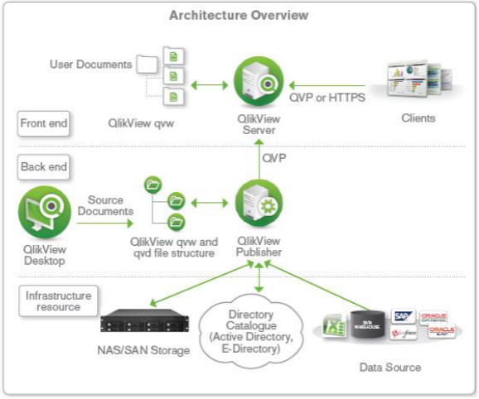
Architecture
Frond End
It contains the QlikView Server which is mainly used by Business users to access the already created BI reports
These user documents are in the format .qvw
The QlikView server in the front end manages the client-server communication between the user and QlikView backend system.

Slide 4
Back End
The QlikView backend consists of QlikView desktop and QlikView publisher.
The QlikView desktop is a wizard-driven windows environment that has the features to load and transform data from a source.
Its drag and drop feature is used to create the GUI layout of the reports that becomes visible in the front-end.
Also .qvw files can be modified to store the data-only files which are known as .qvd files.
QlikView is more of an all-encompassing dashboard application. It focuses on a variety of business intelligence tools, like QlikView Expressor (a quick and smart metadata intelligence solution) and NPrinting (an application for report generation, scheduling, and distribution).
QlikView has a clean interface, is easy to understand, and integrates easily with Excel.

Slide 5

Maintenance
• In-memory technology that automatically maintains relationships between various data sources. • Data compressed into 10% of the original size – optimizing processing speeds. • Direct calculations provide a lightning-fast user experience.

Slide 6

Growth
• As your business data and storage needs to grow, QlikView grows with you. • High-tech architecture that serves even the world’s biggest multinational. • QlikView manages thousands of users and billions of data records.

Slide 7
SECURITY
The data security provision of the tool is very stringent and the creators guarantee the safety of critical corporate data. Full assurance of no security breach is given to the customer.
Authorization of user privileges takes place at two levels in QlikView.
Document Level Security
The document or application level security decides what documents or section of a document an authenticated user will allow to see and open. There are two modes of document-level security in QlikView,
NTFS Mode (Windows control the file access)
DMS Mode (QlikView controls the file access)
Data Level Security
This secures data access at the very initial level i.e. data level. This type of QlikView security methods is when the admin needs to decide what section of the entire data set is the user allow to view and use. There are two ways to accomplish data-level security which can use individually or in combination. They way

Slide 8
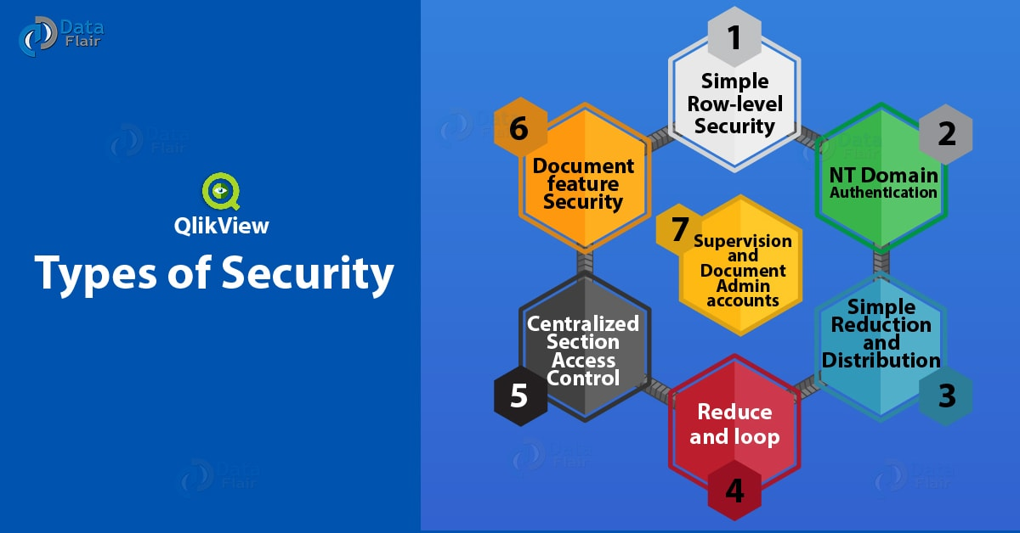
SECURITY

Slide 9
Benefits
Low Maintenance
The implementation of the software is very simple and hassle-free. Even in the later years, the software doesn’t need much maintenance or technical supervision.
Speed
QlikView speed in data delivery is not hampered even after multiple user requesting data. The in-memory system is so efficient that it can cater to as many clients as possible.
Data Compression
In data analysis, the system loads only take the useful bits of data and remove all the unnecessary ones. The QlikView software compresses the entire data to 10% of its original size. Only the useful junks for data analysis remains.
QIX Engine
The QIX engine of Qlikview instantly responds to every click made by the user and changes colour hues by highlighting the data related to the selected field.
This helps the customer to focus on just those colour-highlighted sections in the whole data report and analyse it.

Slide 10
Pitfalls
Less RAM Limit
QlikView can load heavy data but the computer’s RAM sets a limit to it. The extent of data load depends on the RAM of the system. The number of fields, tables, the cells and rows in a table also depends on the RAM capacity of the device.
Difficult Application Development
The end user application development is a bit difficult because it demands technical expertise. The development of applications and script writing requires someone who is well versed with SQL.
Embedding
Embedding or integrating Qlikview with other software might seem a little odd as it has the very distinct appearance.
Work on Old Functions
QlikView has grown old in the sense of the tools and interface it offers to the customers. It lacks the newly liked drag-and-drop function and modern interface which gives the latest competitors an edge over Qlikview.

